Slide 1

TLAP UPDATES 2025
BPR ETHICS WORKSHOP
TLAP and Lawyer Mental Health Trends
ABA Model Rule on Conditional Admission
Baseless DOJ Investigation Closed
New Era of Collaboration Between Programs
J.E. Buddy Stockwell III, JD, CCI
Executive Director
Tennessee Lawyers Assistance Program
(615) 741-3238
Buddy.Stockwell@tncourts.gov
www.tlap.org
All Rights Reserved © 2025

Slide 2

PART ONE Update on Statistics and Trends Lawyer Mental Health TLAP Support

Slide 3



A LOT OF PRESSURE
2025
ALIENS!
ZOOM & TECH!
Alcohol & Cancer
TikTok
Snipers!
STRESS OF PERSONAL
BUSINESS AND FINANCES
Spy
Balloons
Pollution
WORK AND
CASE LOADS
FIRES!
INFLATION
COVID
A.I.
Identity theft
CLIMATE CHANGE
TOXIC POLITICS!!
HATERS
HACKERS
DISINFORMATION
KIDS AND SCHOOL!!!
DRUGS and FENTANYL
SOCIAL MEDIA
“SCREENS” ALL DAY & NIGHT!
FLOODS!
AIRLINE SAFETY
WARS!!
MASKS?!
DRONES
24/7 NEWS
PASSWORDS!☹
NUCLEAR
WAR!!??!
WORKING REMOTELY
IMMIGRATION
DEPORTATION
HOSTAGES!
“SOUTHERN BORDER”
SHUTDOWNS

Slide 4
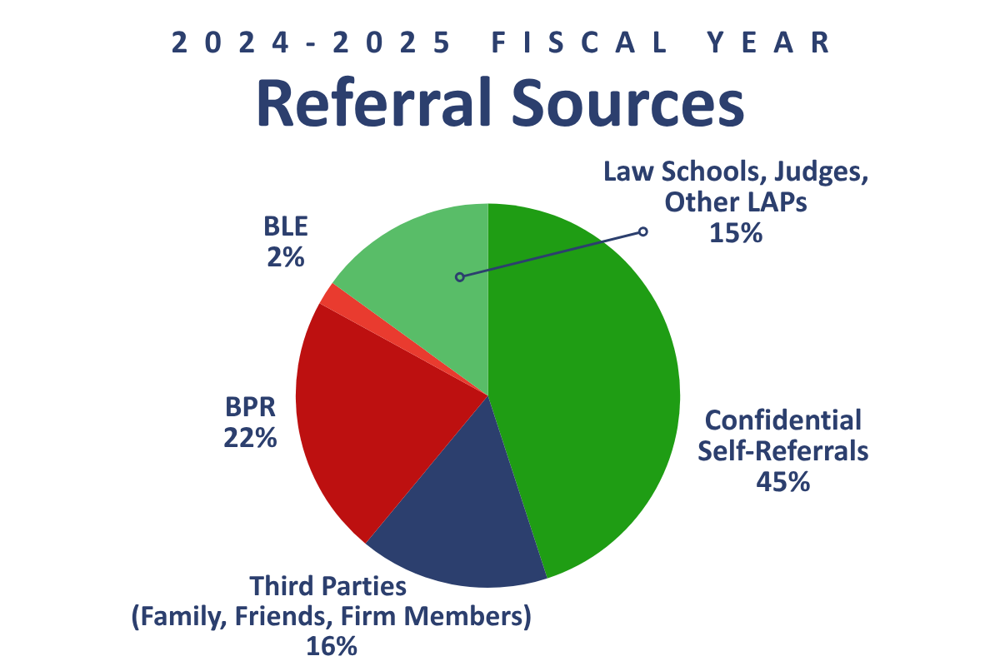
TLAP Case Loads

Slide 5
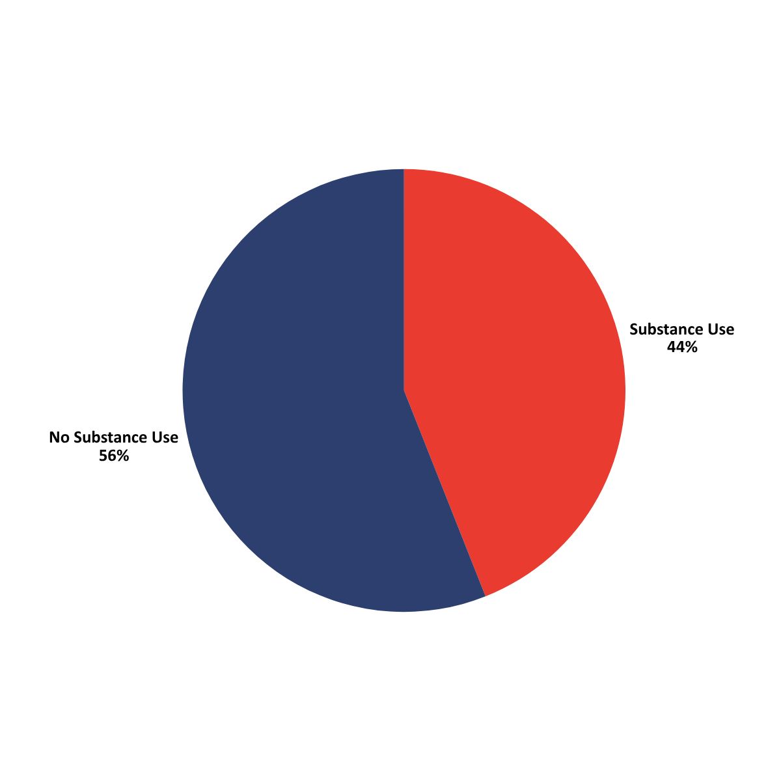
TLAP Case Loads
TLAP Provides Comprehensive
Mental Health Support

Slide 6
Alcohol and Depression
2016 ABA Hazelden Study:
The Prevalence Substance Use
and Other Mental Health Issues
Notes:
Attorneys compared to the General Population:
ALCOHOL USE DISORDER:
20.6% of attorneys (vs. 6.4% of adult Americans 2014)
MAJOR DEPRESSIVE EPISODE:
28% of attorneys (vs. 6.6% of adult Americans 2014)
Bottom Line: Alarming Results

Slide 7
Lawyer Mental Health
Lawyers over the course of their legal career:
Anxiety 61.1%
Depression 45.7%
ADHD 12.5%
Panic Disorder 8.0%
Bipolar Disorder 2.4%
11.5% reported suicidal thoughts during their career
REMINDER:
TLAP OFFERS COMPREHENSIVE MENTAL HEALTH HELP
2016 ABA Hazelden Study:
The Prevalence Substance Use
and Other Mental Health Issues

Slide 8
Compassion Fatigue
Cumulative physical/emotional/psychological effect of continual exposure to traumatic events and distressing stories
While working in a helping capacity
Where demands outweigh resources
CRIMINAL AND DOMESTIC LITIGATION
HIGHEST RISK

Slide 9
Lawyer Dementia On The Rise
The Senior Tsunami is here now (Baby Boomers)
Judges and lawyers equally at risk
TLAP is a very safe place to call confidentially
Call about you, or another lawyer/judge
Interventions are available
TLAP is seeing an increase in these cases
Simple path forward: neurocognitive assessment
TLAP-approved providers qualified to determine fitness

Slide 10
Sept 2025 ABA CoLAP Presentations
1. Holding it All Together: Supporting Solo and Small-Firm Attorneys
2. Suicide Prevention, Postvention and Safe Messaging
3. The New Model Rule on Conditional Bar Admission
4. Impact of Professional Sexual Misconduct in Recovery
5 Lawyers Don’t Need Fixing, the Practice of Law Does
6. The Myth of the Highly Functional Attorney Addict
7. Trauma-Informed and Person-Centered Approaches in LAP Work
8. Fluctuating Futures: Navigating The Everchanging Legal Job Market
9. Weed & Wellness: Cannabis in the Legal Profession
10. Resourcing the Second Half: Midlife, Retirement, and Beyond
11. Polyvagal Theory and the Practice of Law: Inner/Outer Supports
12. Understanding Legal Professional Well-Being
13. Another Arrow for the Quiver- LAPs Promote Wellbeing
14. Attorney Wellbeing & Accountability

Slide 11
PART TWO
NEW ABA MODEL RULE
Conditional Admission
February 2025
https://tlap.org/wp-content/uploads/2025/02/ABA-CoLAP-Resolution-608.pdf

Slide 12
New ABA Model Rule on Conditional Admission
Unanimously adopted by ABA on February 3, 2025.
Three years in drafting by CoLAP Law School Committee.
Judge Butch Childers (Ret) from Memphis on Comm.
Totally replaces old C/A Rule of 2008.
Reflects 17 Years of medical advancements in monitoring.
Available at https://tlap.org/faqs/

Slide 13
Uniform ABA Support
ABA Commission on Disability Rights (co-sponsor with ADA input)
ABA Commission on Interest on Lawyers’ Trust Accounts
ABA Standing Committee on Ethics and Professional Regulation
ABA Standing Committee on Lawyer Referral & Information Service
ABA Standing Committee on Lawyer’s Professional Liability
ABA Standing Committee on Professional Regulation
ABA Standing Committee on Professionalism
ABA Standing Committee on Public Protection Legal Services Law Practice Division
ABA Section of Civil Rights and Social Justice
ABA Section of Legal Education and Admissions to the Bar
ABA Law Student Division
ABA Young Lawyers Division

Slide 14
Publicly Forging the New Rule
2022 National CoLAP Conference Panel Discussion:
Panel included bar applicants, regulators, members of the judiciary.
How long should monitoring lengths be?
What conditions are over-reaching or too burdensome?
Is monitoring punitive/probationary (“sentencing guidelines?”)
Is monitoring medical (“case-by-case by individualized care?”)

Slide 15
Operation of Medical Model
The length of the conditional admission should be based on the individualized clinical assessment of the applicant’s situation in light of prevailing scientific information (clinically determined).
Conditional admission should not exceed sixty (60) months (five years), except for cause (non-compliance; ethical complaint, etc.).
Applicants should get credit for monitoring during law school.
Individualized = case-by-case diagnostics, treatment, monitoring.
TLAP: is there a “current clinical situation”?

Slide 16
ASAM Settles Medical Debates
Per ABA Resolution 608:
“The new ASAM Criteria 4th Edition has subsequently been published, and many issues are resolved in Chapter 23 of that publication through acknowledging the medical framework for best practices in the monitoring and treatment for legal professionals including lawyers and judges.”
See details at www.tlap.org (resources; TBA Articles):
“ASAM Criteria 4th Edition; Blueprint for Addiction Treatment”

Slide 17
PART THREE DOJ RETRACTS “BASELESS” ALLEGATIONS OF ADA VIOLATIONS BY TBLE AND TLAP The Pivotal Issue: “Conduct”

Slide 18
State Courts Regulate Practice
The DOJ alleged that the two bar applicants were discriminated against by TBLE and TLAP based on diagnosis and disability.
In fact, these bar applicants were referred to TLAP due to concerns regarding conduct.
“Conduct” issues in BLE matters can often involve issues such as:
arrests, acts involving academic or employment related misconduct, acts involving dishonesty, fraud, deceit or misrepresentation, neglect of financial responsibilities or professional obligations, violation of a court order, conduct evidencing mental or emotional instability or drug or alcohol abuse, and lack of candor, etc.

Slide 19
State Courts Regulate Practice
State jurisdictions have the discretion to make their own determinations of a standard of proof for conditional admission.
Conditions may include continued participation in appropriate levels of mental health care and treatment, and other activities, that help prevent recurrence of the conduct at issue.
Court may order participation with its monitoring authority.
TLAP is the TN Courts Monitoring Authority per Rules 33, 7, and 9.

Slide 20
Is Conditional Admission a Right?
Courts do NOT have to offer Conditional Admission
Some states do not have Conditional Admission
Courts can simply deny admission due to the conduct
Conditional Admission is an OPPORTUNITY

Slide 21
Is TLAP Monitoring a Right?
There is no right to TLAP Monitoring Per Rules 33, 7, and 9:
TLAP may accept BLE/BPR referrals; can decline
Case-by-case individualized support
Diversion and Mitigation opportunity
Clinical response to match any current impairment concerns
“Fail First” clinical model is not available (instead, best practices)
No “right” to a cheap and easy clinical path
In rare cases, the impairment may be too severe to overcome
TLAP Zero Tolerance on Abusive Behavior

Slide 22
TN Court Leads the Way for ADA
TN Supreme Court Justice Janice Holder cited in Resolution 608:
In 2011, Justice Holder, authored a Law Review Article discussing conditional admission and ADA compliance.
ADA prevents discrimination based solely on diagnosis or disability.
Tennessee’s conditional admission focuses on “previous conduct or behavior” and “conditions shall be tailored to detect and deter conduct, conditions or behavior.”
2025 ABA Resolution 608: “This TN approach foreshadowed the changes that we recommend today”

Slide 23
New ABA Rule: Cites Louisiana/DOJ
In 2014, the United States Government entered into a Settlement Agreement with the Louisiana Supreme Court regarding Bar Admission procedures for evaluating applicants with mental health disabilities. (JLAP not a Party and never in violation of ADA)
The LA Settlement Agreement clarified that the ADA prohibits bar application questions about mental health/diagnoses and that Louisiana “not recommend or impose conditional admission solely on the basis of mental health diagnosis or treatment.”
The Louisiana ADA Settlement does not apply whatsoever to questions and matters that involve an applicant’s conduct.

Slide 24
TLAP Already in Sync
100% of BLE referrals to TLAP are based on “conduct”:
Bar applicants in TN are never asked about mental health/diagnoses
It is impossible for BLE to refer to TLAP based on disability/diagnosis
TLAP is not involved with who is referred to TLAP by the BLE
TLAP does not decide who is admitted to the practice of law in TN

Slide 25
Jurisprudence
“That the States have broad power to regulate the practice of law is, of course, beyond question.” United Mine Workers of Am., Dist. 12 v. Ill. State Bar Ass’n, 389 U.S. 217, 222 (1967).
“Regulating the practice of law in Tennessee is an inherent duty of this Court.” In re Parrish, 620 S.W.3d 326, 329 (Tenn. 2021).
A “license to practice law in this state is not a right, but a privilege.’” Bd. of Prof. Resp. of Sup. Ct. of Tenn. v. Barry, 545 S.W.3d 408, 426 (Tenn. 2018).
“It would disserve the public and the legal profession—and applicants themselves—to provide law licenses to applicants in disregard of potentially disqualifying conduct on the ground that obtaining help for a related substance use disorder may be ‘burdensome’.”

Slide 26
TN AG DEFENDS TBLE and TLAP
DOJ published a Letter of Findings in December 2024
The Letter alleged ADA Violations by TBLE and TLAP
AG provided a comprehensive response to the DOJ
DOJ formally closed the matter on August 22, 2025
DOJ removed its Letter of Findings from DOJ’s website
(A DOJ Letter of Findings constitutes mere allegations)

Slide 27
TN AG DEFENDS TBLE and TLAP
Per AG Press Release on August 26, 2025:
“The DOJ’s investigation [of TBLE and TLAP] was based upon claims by two bar applicants who alleged that they were discriminated against based on diagnoses and/or disability. Those claims were false and had no merit.
The applicants were referred to TLAP by the TBLE due to histories of concerning conduct, which required those applicants to comply with reasonable medical assessments and monitoring as conditions for practicing law in Tennessee.”

Slide 28
TN AG DEFENDS TBLE and TLAP
More:
“We are glad the Department of Justice has closed this misguided matter attacking common-sense guardrails protecting the integrity of the practice of law in Tennessee.”
“The investigation and findings were baseless overreach. I’m proud of Tennessee’s track record of upholding the highest professional standards while ensuring that qualified people have equal opportunity to practice law, regardless of disability status.”

Slide 29
PART FOUR PATH TO LAPS AND RECOVERY SUCCESS A NEW ERA of COLLABORATION BETWEEN PROFESSIONALS’ MONITORING PROGRAMS

Slide 30
IS THERE A LEVEL OF CARE THAT APPROACHES A NO-RELAPSE “CURE” FOR SUBSTANCE USE DISORDERS? Monitoring Programs for Licensed Professionals Can Come Close . . .

Slide 31
LA JLAP Monitoring Results
NO RELAPSE RATES:
2016: 94%
2017: 97%
2018: 94%
2019: 96%
2020: 95%
2021: 97%
2022: 98%
2023: 100%
96% No Relapse Average Over 8 Year Span
Average Population
100 Participants
SSW Diag and Txt
Post-Txt LAP Monitoring
Verified With:
H Panel w/Urine EtG PEth Blood
Random and Global

Slide 32
TN TLAP Monitoring Results
NO RELAPSE RATES:
2022: 85%
2023: 88%
2024: 89%
2025: 92%
88% No Relapse Average Over 4 Year Span
2020: TLAP
IMPLEMENTED
ASAM SSW

Slide 33
2015 JLAP Audit

Slide 34
2025: Ten Years Later
Lawyers have been treated at higher levels for decades
Professionals’ Monitoring Programs no longer siloed
ABA recognizes medical levels of care in Model Rule
“Gold Standard” Recovery Rates are now expected
THIS DEALS A POWERFUL BLOW TO ADDICTION

Slide 35
ASAM Ch. 23: Three Factors
By definition, Safety-Sensitive Occupations (SSO) have a responsibility to the public
Three factors:
Size of population affected
Magnitude of effect from potential impairment
Amount of implied public trust in the profession

Slide 36
Examples of SSO Industries
Health Care
Transportation
Security and First Responders
Energy
Lawyers and Judges

Slide 37
Safety-Sensitive Workers
Licensed Professionals Who:
manage a complex body of education and training
work in a demanding and difficult environment
real-time decisions must be made quickly under stress
mistakes can’t be corrected and/or are very costly
mistakes can visit irreparable harm upon the public

Slide 38

Airline Pilots On Any Given Day: NO SECOND CHANCES

Slide 39
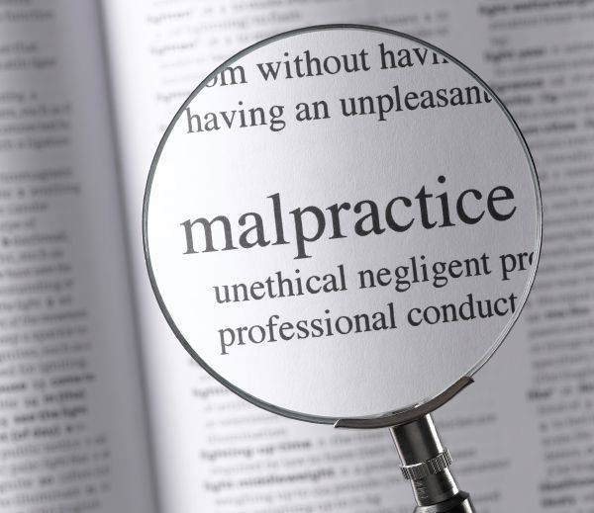



LAWYERS: Deadlines; Evidence NO SECOND CHANCES

Slide 40

Unique to Lawyers
Client Trust Accounts: They Hold Money

Slide 41
Federal: Transportation
Transportation (DOT)
Aviation (FAA)
Motor Carrier (FMCSA)
Railroads (FRA)
Transit (FTA)
Highways (NHSTA)
Pipelines (PHMSA)
Marine (U. S. Coast Guard)

Slide 42
State Regulated
Health Care:
Doctors
Nurses
Etc.
Public Administration:
Judges
Lawyers
Politicians
Etc.
TLAP and Monitoring is a response to
CONDUCT ONLY (Arrests, Complaints, Impairment, Lack of Candor, etc.)
The entire profession does not
Drug Screen, etc.

Slide 43
TLAP Mission Statement
TN Court Rule 33; TLAP has three purposes:
(1) to protect the interests of clients, litigants and the general public from harm caused by impaired lawyers or judges; (2) to assist impaired members of the legal profession to begin and continue recovery; and (3) to educate the bench and bar to the causes of and remedies for impairments affecting members of the legal profession.

Slide 44
TLAP’s is The Monitoring Authority
TLAP is the TN Court’s specified “monitoring authority” and diversion track for impairment issues:
Disciplinary Cases
Bar Admission Cases
Expectations: TLAP must utilize Clinical Best Practices and render “Gold Standard” programming to support objectively reliable recovery and fitness to practice.

Slide 45
“TLAP Compliance”
Is a “stipulation” in Sections of Court’s Rules, that:
Appropriate ASAM SSO Clinical Standards met
Impairment Removed
Clear and Convincing Evidence; safe to practice
Close Supervision via LAP Monitoring
Self-Regulation of Law Profession accomplished
Saves Lives and Careers at VERY HIGH RATES
Public/Profession not in Danger

Slide 46
VERY SIMPLE ASAM SSO PATH (DOES NOT MEAN IT’S EASY; ADDICTION HATES THIS PLAN)
SSO Diagnostics
SSO Treatment
TLAP Monitoring

Slide 47

General Public “Fail First Model”
Inpatient
Partial
Hospitalization
Intensive
Outpatient
Outpatient
A.A./N.A.

Slide 48
Safety-Sensitive Workers “Success First Model”
Inpatient SSW-Level
Partial
Hospitalization
Intensive
Outpatient
Outpatient

Slide 49
What About Voluntary Cases?
TLAP has vigorous traffic from lawyers with no disciplinary issues calling TLAP in strict confidence for help.
TLAP conducts confidential interventions (judges and lawyers). Many follow TLAP’s advice. Some do not. TLAP’s door is always open.
TLAP cannot monitor in any context unless person is fully compliant and ASAM SSW fit to practice.
TLAP is consistent across the board in clinical support and levels of care that saves lives and careers.

Slide 50
ASAM CH. 23 on MAT/MOUD
Medications can be useful components of treatment plans, but long-term use needs to be carefully considered
Cognitive testing should be used to rule out impairment
ALL SUDs treated; no “active” SUDs;
Medications are never banned; Case-by-Case diagnostics
TLAP can monitor when medications are needed

Slide 51
MAT plus Mind Body Spirit
“A sober horse thief is still a horse thief”
“There is no chemical solution to a Spiritual Disease”
Without Comprehensive Treatment, STILL AT RISK:
Unresolved co-morbidity, other active SUDs
Unresolved trauma, guilt, and shame
Continuing self-centered and disruptive behavior
Not taking responsibility for behavior and consequences
Playing the victim

Slide 52

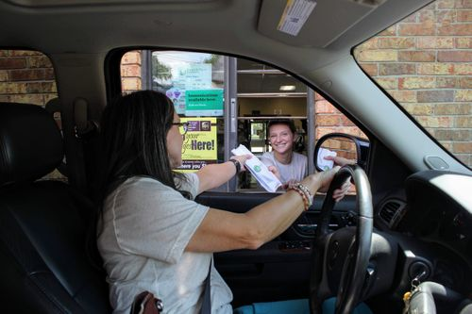
DOES ADDICTION CARE?
Adderall/Vyvanse
Oxycodone/Hydrocodone
Methadone/Suboxone
Ketamine/Cannabis
Meth/Cocaine
Heroin/Fentanyl
Cannabis

Slide 53

Matthew Perry
“Please Stop Killing Our Friends”

Slide 54
The Coroner’s Report
December 15, 2023 - The County of Los Angeles Department of Medical Examiner (DME):
The cause of death for 54-year-old actor Matthew Langford Perry as the “acute effects of ketamine.”
Contributing factors in Mr. Perry’s death include drowning, coronary artery disease and the effects of buprenorphine (Suboxone). No other drugs mentioned.
The manner of death is deemed an accident

Slide 55

Doctor Drew Penski Calls BS
“It wasn’t just the Ketamine. It’s very important to understand here that he was on Buprenorphine [Suboxone] and also on two different Benzodiazepines (Klonopin and Xanax), which for a recovering addict, is bizarre and ridiculous.”

Slide 56
More From Dr. Drew
Penski’s professional opinion on the Perry tragedy:
It would be “out of the question” to have someone struggling with addiction on buprenorphine (Suboxone), benzodiazepines, and ketamine at the same time:
“It’s wild, it’s dangerous, and for somebody with addiction, you see where it goes [death]. It’s a terrible tragedy.”
ONLY DR. DREW REPORTED ALL OF THE ADDICITVE PRESCRIPTION DRUGS INVOLVED; THE MEDIA IGNORED IT.
HOW CAN THIS ALL BE HAPPENING?

Slide 57

A RAGING STORM OF CONROVERSY: HOW SHOULD ADDICTION BE TREATED?

Slide 58
A Unique Perspective
I was lucky to have the unique opportunity to unwind from a very busy domestic litigation solo practice in Baton Rouge, LA, and undertake an adventure of a lifetime.
In 2004, I sold my law office, house and cars and bought an ocean rated sailing catamaran.
From 2005 through 2010, lived aboard and sailed 19,000 miles; northward to Cape Cod and southward to entire eastern and western Caribbean, including Venezuela, Colombia, and Panama.

Slide 59

Mixed Emotions/Reactions
Fellow practitioners began calling me the “Shawshank Man” because I was “escaping the practice of law” (per the 1994 film Shawshank Redemption )

Slide 60

In The Storm: Where is True North?

Slide 61

Hold Your Course; Storm Will Pass!

Slide 62
And Now . . . Back to “True North” in Addiction Treatment Best Clinical Practices ASAM SSO Support

Slide 63
Why Five Years of Monitoring
2003 Study: “A 60-year Follow-up of Alcoholic Men”
This Harvard medical study focuses on recovery rates from alcoholism in the general population over the course of a 60-year period of time:
alcoholism is, just like cancer, a chronic disease
cannot really be considered in complete, full remission until there has been no relapse for a period of five (5) years:
“In short, analogous to cancer patients, a follow-up of 5 years rather than of 1 or 2 years would appear necessary to determine stable recovery.”
Vaillant, G. E. (2003). A 60-year follow-up of alcoholic men.
Addiction, 98(8), 1043–1051

Slide 64
TEN YEARS OUT: Physicians
Outcomes are excellent even five (5) years after monitoring concluded, per self-report:
97% still in recovery
79% with no use of alcohol after monitoring
88% have continued 12‐step meetings
85% say cost of LOC/Monitoring money well spent
76% say they would not have been successful without ASAM SSO LOC treatment and monitoring
Merlo LJ, Campbell MD, Shea C, White W, Skipper GE, Sutton JA, DuPont RL. Essential Components of Physician Health Program Monitoring for Substance Use Disorder: A Survey of Participants 5 Years Post Successful Program Completion. Am J Addict. 2022 Mar;31(2):115-122. doi: 10.1111/ajad.13257. Epub 2022 Jan 17. PMID

Slide 65
New TBA Journal Article by TLAP:
TLAP and the Miracle of Recovery
J. E. "Buddy" Stockwell on Nov 3, 2025
Journal Issue Date: November/December 2025
Journal Name: Vol. 61, No. 6
On Aug. 31, I received a wonderful text message from a lawyer we’ll call “Robin”¹:
“5 years sober today. You were my first angels in recovery. Don’t you ever forget it. You saved my life.”
(Chronicles TLAP’s support of a Journey into solid Recovery)

Slide 66
A Level Playing Field
2016: “Risk of Relapse Declines Significantly After 5 Years of Abstinence from Alcohol”
Focused on managing SUDs in the general population
Five (5) years of continuous sobriety
Deemed to finally be stable in remission
Reduces risk of relapse to same level as general population
“Various additional studies have provided further evidence that after 5 years of abstinence, only about 15% of individuals with a historical diagnosis of alcohol use disorder (AUD) will relapse.”
Strikingly important in the context of lawyers, doctor, pilots, etc.
Neuraptitude – NCPHP. (n.d.). Retrieved February 2, 2023, https://www.ncphp.org/wp-content/uploads/2017/06/Relpase-declines-after-5-years.pdf

Slide 67
The Ultimate Issue
There is no constitutional right to practice law or medicine (or even drive a car, etc.), it is a privilege.
Will the Public continue to support licensing professionals who have a history of Conduct and Current SUD/MH impairments?
In the fullness of time, we will succeed or fail in part upon the ongoing development and success of clinical best-practices that objectively certify “fitness-to-practice” and protect the public.

Slide 68
TLAP CONFIDENTIALITY
T.C.A. 23-4-105
The records, proceedings and all communications of any lawyers' assistance program shall be deemed confidential and shall not be available for court subpoena. This section shall not prevent the subpoena of business records that are otherwise available through subpoena. Such records are not to be construed as privileged merely because they have been provided to a lawyers' assistance committee.
76% of TLAP’S CASES HAVE NO REGULATORY INVOLVEMENT AND ARE TOTALLY CONFIDENTIAL!

Slide 69
TLAP Is Stable
“Principles Before Personalities”
Under the directives of the TN Supreme Court TLAP is a state-of-the art fully-formed professionals’ monitoring program.
TLAP has an expert, professional clinical staff skilled in implementing medical best practices per ASAM Ch. 23 for Safety Sensitive Workers, the ABA Model Rules, and TLAP is in full compliance with the ADA.
TLAP will remain in-step with all ongoing medical advances that are essential to the effectively supporting fitness to practice law.

Slide 70

SEE TLAP’s WEBSITE: WWW.TLAP.ORG
FAQs, Annual Reports, and Much More!

Slide 71



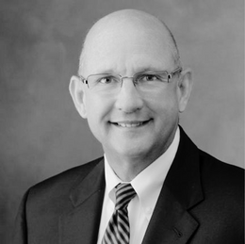

TLAP STAFF
Lauren Castor, LPC-MHSP (temp)
CLINICAL DIRECTOR
Under the leadership of our Executive Director, Buddy Stockwell, our highly-trained staff competently serves the Tennessee legal community with specialized clinical services.
Learn more about our staff on:
https://tlap.org/staff/
Erin Lynch, LPC-MHSP (temp)
CLINICAL CASE MANAGER
Emily Lacey, CRS
OUTREACH & CLINICAL COORDINATOR
J.E. “Buddy” Stockwell III, J.D., CCI
Sarah Burden
OFFICE & MARKETING COORDINATOR
EXECUTIVE DIRECTOR

Slide 72
TLAP WILL HELP YOU!
TLAP provides CONFIDENTIAL professional clinical support to . . .
Lawyers, Judges, and Law Students
Whether it be lawyer-specific tools for everyone in the profession to practice wellness, well-being, and resilience, or addressing a very serious mental health or addiction problem and restoring fitness-to-practice . . .
TLAP is your highly-specialized clinical resource!

Slide 73

THE GOAL OF TLAP
Happy and Healthy Lawyers at Their Best!

Slide 74
THANK YOU!
J.E. Buddy Stockwell III, JD, CCI
Executive Director
Tennessee Lawyers Assistance Program
(615) 741-3238
Buddy.Stockwell@tncourts.gov
www.tlap.org
All Rights Reserved © 2025

